Slide 1
Java Introduction and History

Slide 2
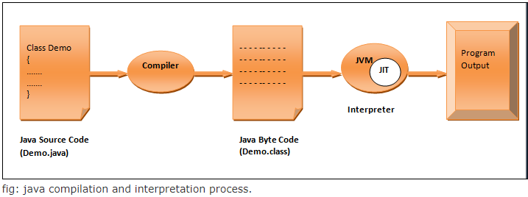
Java is an Object Oriented programming language developed by James Gosling and his team in 1991 at Sun Microsystems. Initially it was called Oak but later in 1995 changed to Java.
Java is compiled and interpreted language -
First of all compiler converts the java source code into a form called Byte Code. This is a file with .class extension and this Byte Code is called platform independent.
This Byte Code is interpreted by Java Virtual Machine (JVM) into executable code. Because JVM is available for almost every available device that's why Java is called platform independent language.

Slide 3
And this Byte Code also provides the security as well as portability to java language.
As java is compiled and interpreted language so one may think that its execution speed is slow than other compiled languages like C or C++. But there is not much difference because Byte Code is highly optimized and JVM can execute it much faster than you think.
Also JVM contain a JIT (Just In Time) compiler that in place of compiling the whole program, compiles only that part of the program that is needed at that time.

Slide 4
How Java came into existence -
The primary motivation for developing the Java was to develop a platform independent language that can be used to create software's for consumer electronic devices like TVs, Microwave Oven, Remote control etc.
The reason behind this is that as different devices makes use of different types of controller so languages like C and C++ etc are not efficient for these types of software development because to run the software we need to design a full version of compiler for these languages for different types of devices available.
This is very time consuming and not an efficient solution.
Java provides efficient solution to this as java is platform independent i.e. can run on any device only we need JVM interpreter for that device.
After some time James Gosling and his team member realize that the same problem that java was initially designed to solve on a small scale could also be applied to the internet on large scale.
So they changed focus from consumer electronic devices to internet programming. And now it has been widely used in this field also.

Slide 5
Basic Concepts of OOPS, Class, and Object in Java -
Object Oriented Programming System (OOPS) is based on the concept of Objects. To solve a problem in OOPS (or we can say - to develop any software using OOPS), the first step is to identify the objects in problem, and then build data (variables) and functions (methods) around these objects.
Object
Object is an entity that may represent a human being, a place, a thing or any other item required to solve a problem. Objects may contain Data (variables in programming) and functions (methods) associated with them.
Object = Data + Methods
An object can access the data associated with itself only, and objects can communicate with each other using functions(methods) -

Slide 6
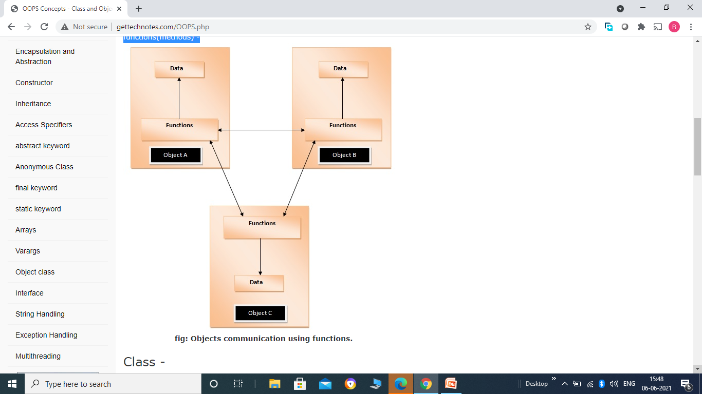
Class -
A class is a collection of objects of similar types. It is a container, for example 'Student' is a container for different students in a class. In this case particular student, for example Jerry, will be object of class Student.

Slide 7
Syntax for declaring a class –
class <Class_Name>
{
// body of class
}
For Example –
class Student
{
// Variables
// methods etc.
}
Creating Object in Java -
Java provides a keyword named new to create objects.It allocates memory for objects in Heap data structure at runtime. Syntax-
Class_Name Object_Name = new Class_Name()
Where - Class_Name - is the name of class of which we want to create object. Object_Name - is the name of object. For Example - For a class named 'Student', we can create object as follows - Student st = new Student() Where - Student - is the class name. st - is the object name.

Slide 8
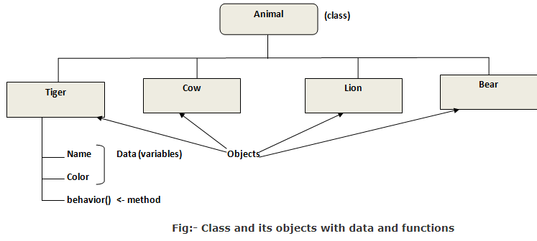
Class does not have physical existence only objects exist physically :-
Class is a logical entity, it does not have physical existence. We can define it in two ways :-
1- In General -
Consider a class 'Animal'. There is nothing exists in the word physcially with the name Animal, it is just a class used to define different entities (Objects) such as Tiger, Cow etc. Only these entities exist physically in the real world.

Slide 9
In the above figure Animal represents a class which contains objects named Tiger, Cow, Lion and Bear (all of same type means belongs to animal category). And each object may have data and methods associated with them. 2- In Programming-
Technically it means that - no memory is allocated for classes whatever data members it contains, memory is allocated to objects only. For example consider the following class-
class Students
{
int id, marks;
}
Here class Demo contains 2 integer variables; in java an integer takes 4 bytes in memory, so you would thing that Student class will take 8 bytes of memory. But no memory will be allocated to these variables, until we create objects of this class. So as soon as we write the following line of code - Student st1 = new Student();
compiler will allocate 8 bytes of memory space to object.

Slide 10
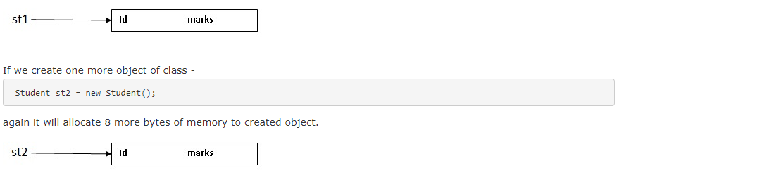

Slide 11
Writing and executing simple 'Hello World' java program –
The best way to learn Java is by directly writing programs. Here we are assuming that the reader is having at least the basic knowledge of C or C++ language.
Setting up Java Runtime Environment on your local machine -
Before we can write and execute any java program, we need to set up java runtime environment on our local machine. For that, we have to follow the following steps - 1- Download JDK - To execute java programs, you need a compiler and interpreter, and they are provided by a software named Java Development Kit (JDK). SO first of all you need to download the latest version of JDK from Oracle website and install it. You can download it from the following link - https://www.oracle.com/technetwork/java/javase/downloads/index.html

Slide 12
2- Set path for JDK - After installing the jdk you need to set the path for java. To set path follow the following steps - i - Go to MyComputer and then open Local Disk (C). There will be a folder named Program Files.
ii - Open the folder and you will find another folder named Java. iii - Open that folder and you will find a folder named jdk1.8.0_102 (the number following the jdk may vary depending upon the version of jdk you installed). iv - Open that folder and you will find a folder named bin, after that just copy the complete address shown in address bar (that may look like this - C:\Program Files\Java\jdk1.8.0_102\bin) v - Now right click on MyComputer and go to Properties there you will find a option named Advanced system setting, click on that. vi - A windows will open, find a option named Environment Variables and click on that.
vii - A a new window will open click there on New option. It will open a new window named New User Variable. viii - It contains two option variable name and variable path. Enter variable name as 'path' and in variable value paste the path that you have copied previously.

Slide 13
Hello World Program -
Open the Notepad and write the following program
class Demo
{
public static void main(String args[])
{
System.out.println("Hello World");
}
}
Program Description -
The first line - class Demo - declare a class where class is a keyword which is used to declare a class in java. In java everything should be within the class. Demo is the name of class , it is user defined and it can be any valid java identifier.
The next line - { - is opening curly braces from where body of the class started.

Slide 14
Next line - public static void main(String args[]) - is the main method from where java program execution starts. Main() function contains a number of keywords -
public - public is an access specifier that causes the main function to be accessed everywhere. We will cover access specifiers in detail later. main() method is public because compiler has to access the main() function to start execution and compiler is outside the program so to make main() function accessible to compiler main() is declared as public.
static - static is another keyword used in java, and a static method can be accessed without creating objects of that class. As main() is the entry point in program so till then no objects have been created and we have to access the main() method so to directly call main() without creating object, main() is declared as static.
void - void is the return type , which tells the compiler that main is not going to return any value.
String args[] - Here main should have a String type array as parameter and name of array can be any valid java identifier generally we use args.
The next line - System.out.println("Hello World") - causes Hello World to be printed on console screen. Note : println() method belongs to PrintStream class.

Slide 15
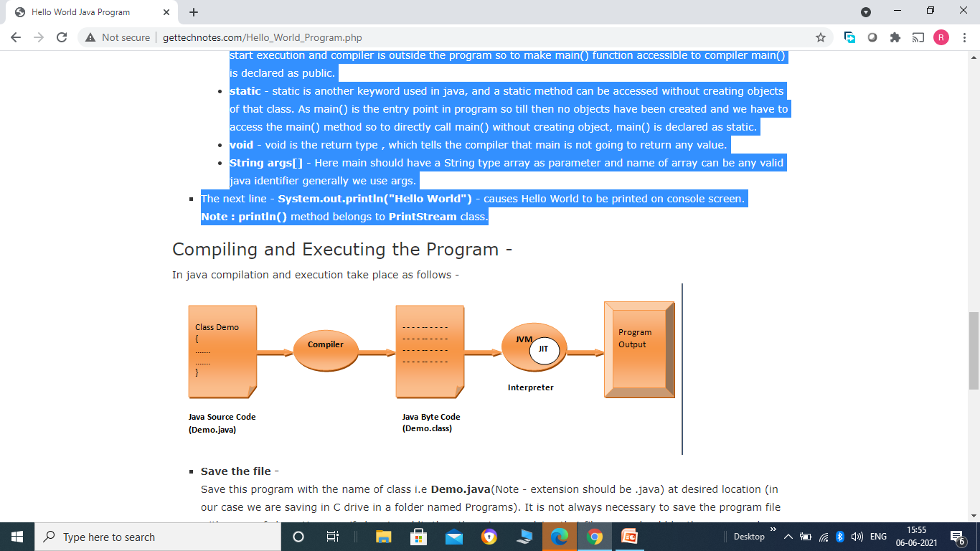
Save the file - Save this program with the name of class i.e Demo.java(Note - extension should be .java) at desired location (in our case we are saving in C drive in a folder named Programs). It is not always necessary to save the program file with name of class. However if class is public then there is compulsion that file name should be the same as class name.
Now open command prompt by writing cmd in search box or run box. First of all we need to go to the location where program is saved (i.e Programs folder in C drive) as shown below-

Slide 16
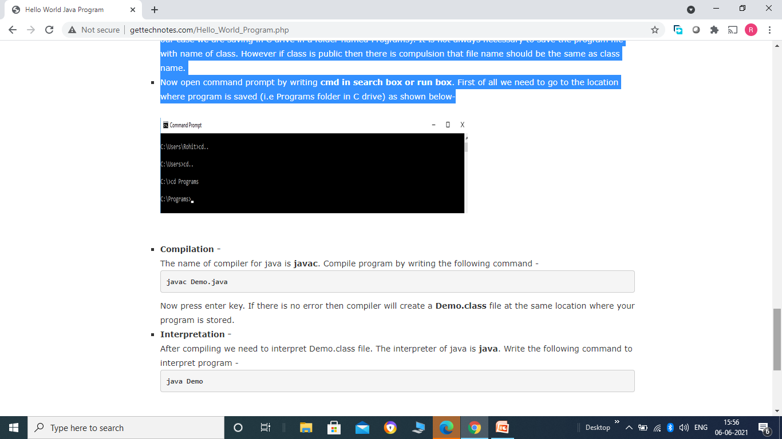
Compilation - The name of compiler for java is javac. Compile program by writing the following command - javac Demo.java Now press enter key. If there is no error then compiler will create a Demo.class file at the same location where your program is stored.
Interpretation - After compiling we need to interpret Demo.class file. The interpreter of java is java. Write the following command to interpret program - java Demo Now press the enter key and output will be displayed on the screen as shown below -

Slide 17
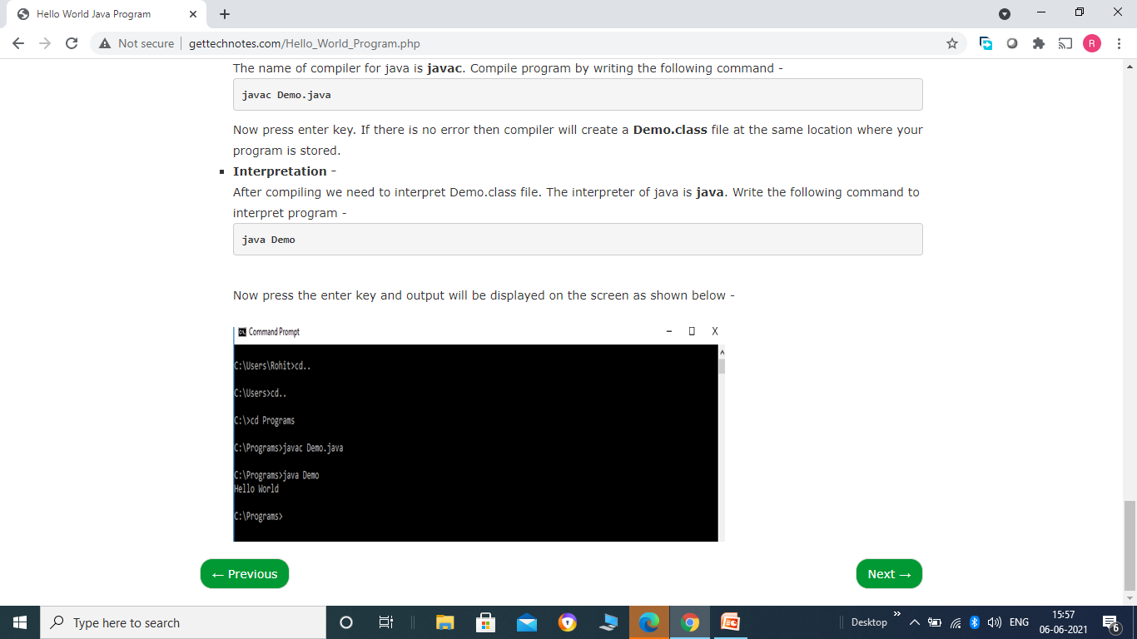

Slide 18
Naming Conventions Used in Java -
(Notations Used : U -> for Uppercase letter, L -> for Lowercase letter)
Java follow a standard naming convention for their classes, methods and variables names. All the predefined classes, methods and variables are written using this naming convention. You are note forced to follow the same naming convention, but it is a good practice to follow the same naming convention.
Class Name - U_____U______U_____U_____ : A class name may be a combination of one, two or more English words; the first letter of each word in the class name is Capital. This convention is followed by all the predefined classes in java. For example - System, PrintStream, InputStreamReader etc
Methods name - L______U______U______U______ : Method name may also be a combination of one, two or more words, the first letter of first word is in lowercase and the remaining letter's first word is in uppercase. This convention is followed by all the predefined methods in java. For Example - parseInt(), readLine(), console() etc.
Variables name : Variables follow the same naming convention as methods.

